Slide 1
Recent Demographic Trends in Sweden Part 1: Context
A collaboration between the African American Registry and the American Swedish Institute
Presented by Liz Stopka, ASI Language Programs Coordinator

Slide 2
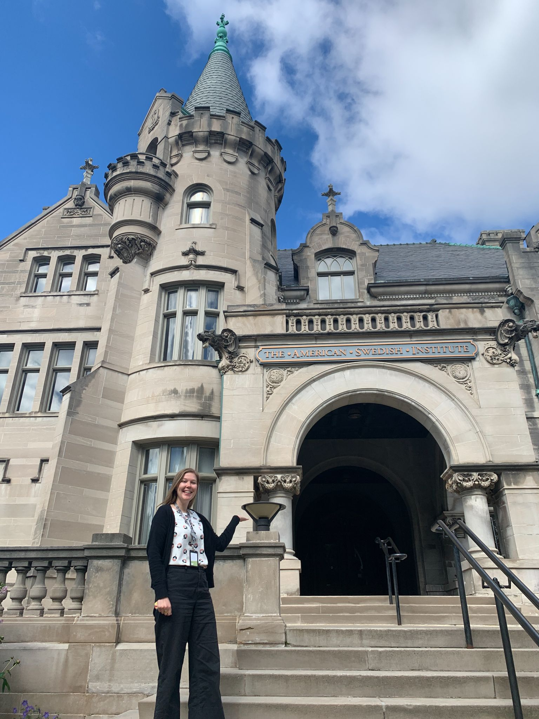
Hej och Välkommen till lektion 1!

Slide 3
Before we start...
What images come to mind when you think of Sweden or Swedish people?
Take a moment to think and jot down some notes.

Slide 4
In today’s lesson...
Communicate a basic introduction to Sweden and its people
Provide a context for understanding the position of Black Swedes
In part 2 of the video, we will explore basic Swedish vocabulary related to Swedish demographics

Slide 5
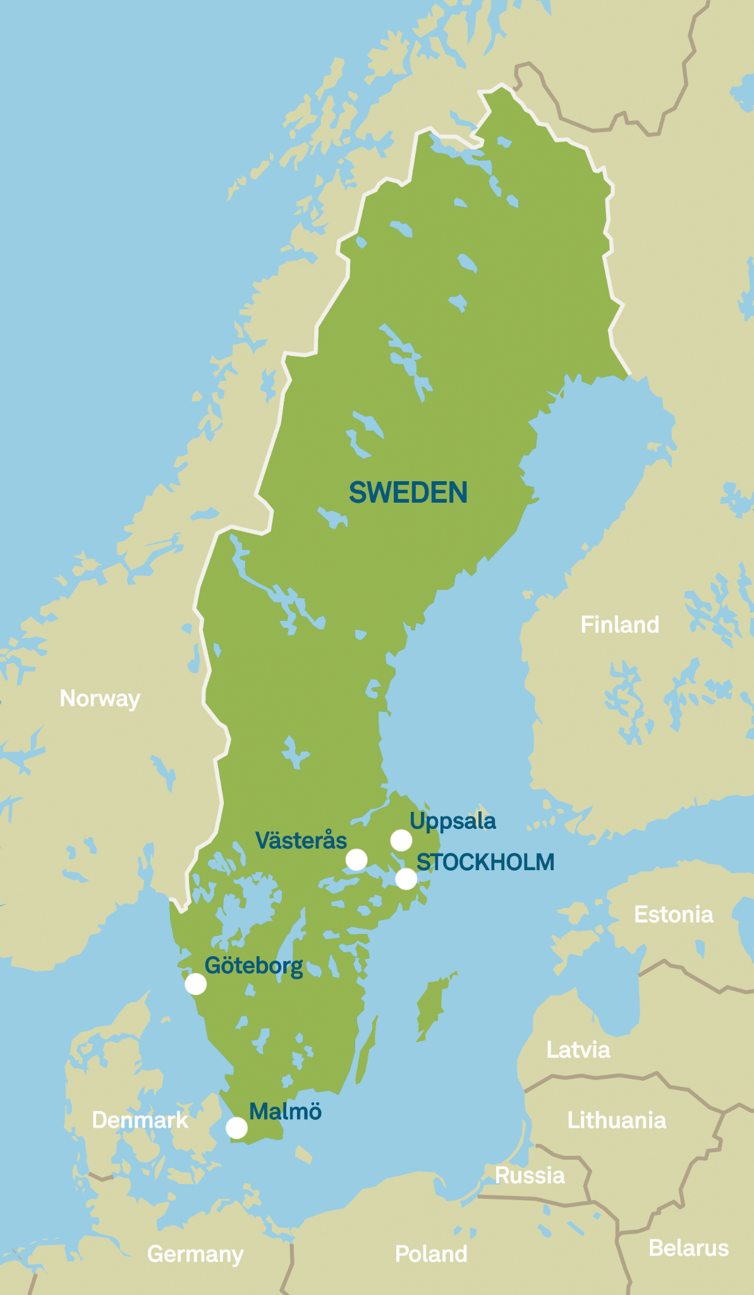
Where is Sweden?
Northern Europe
Part of Scandinavia - Denmark, Norway, Sweden
Part of the Nordic countries - Finland, Iceland, Denmark, Norway, Sweden

Slide 6
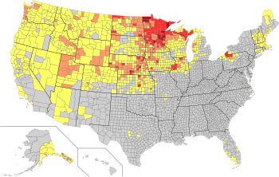
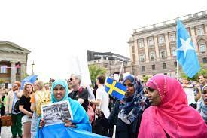
Historical context : Migration in Swedish history
Major emigration from Sweden
Around 1.3 million Swedes left from mid 1800s - early 1900s
Many settled in the US
Minnesota / Midwest - Homestead Act of 1862
Waves of immigration to Sweden
Pre WW II
Post WW II
Recent years
Sweden’s colonial period and participation in the slave trade (1638 - 1878)

Slide 7
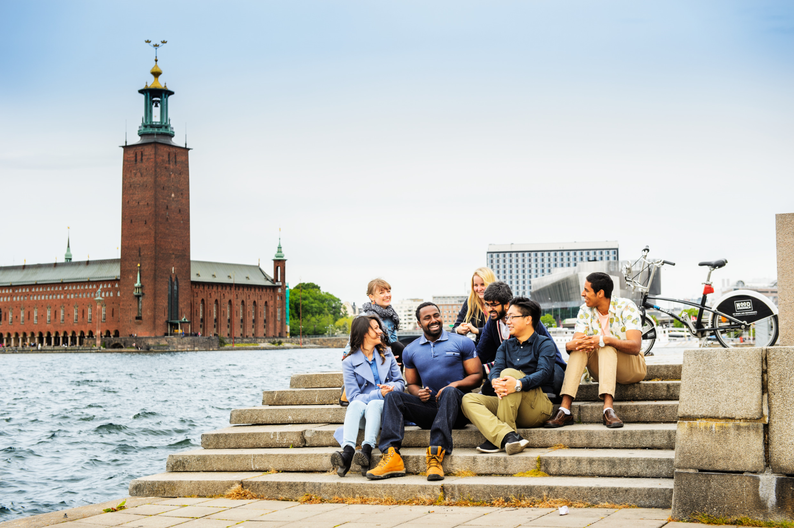
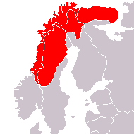
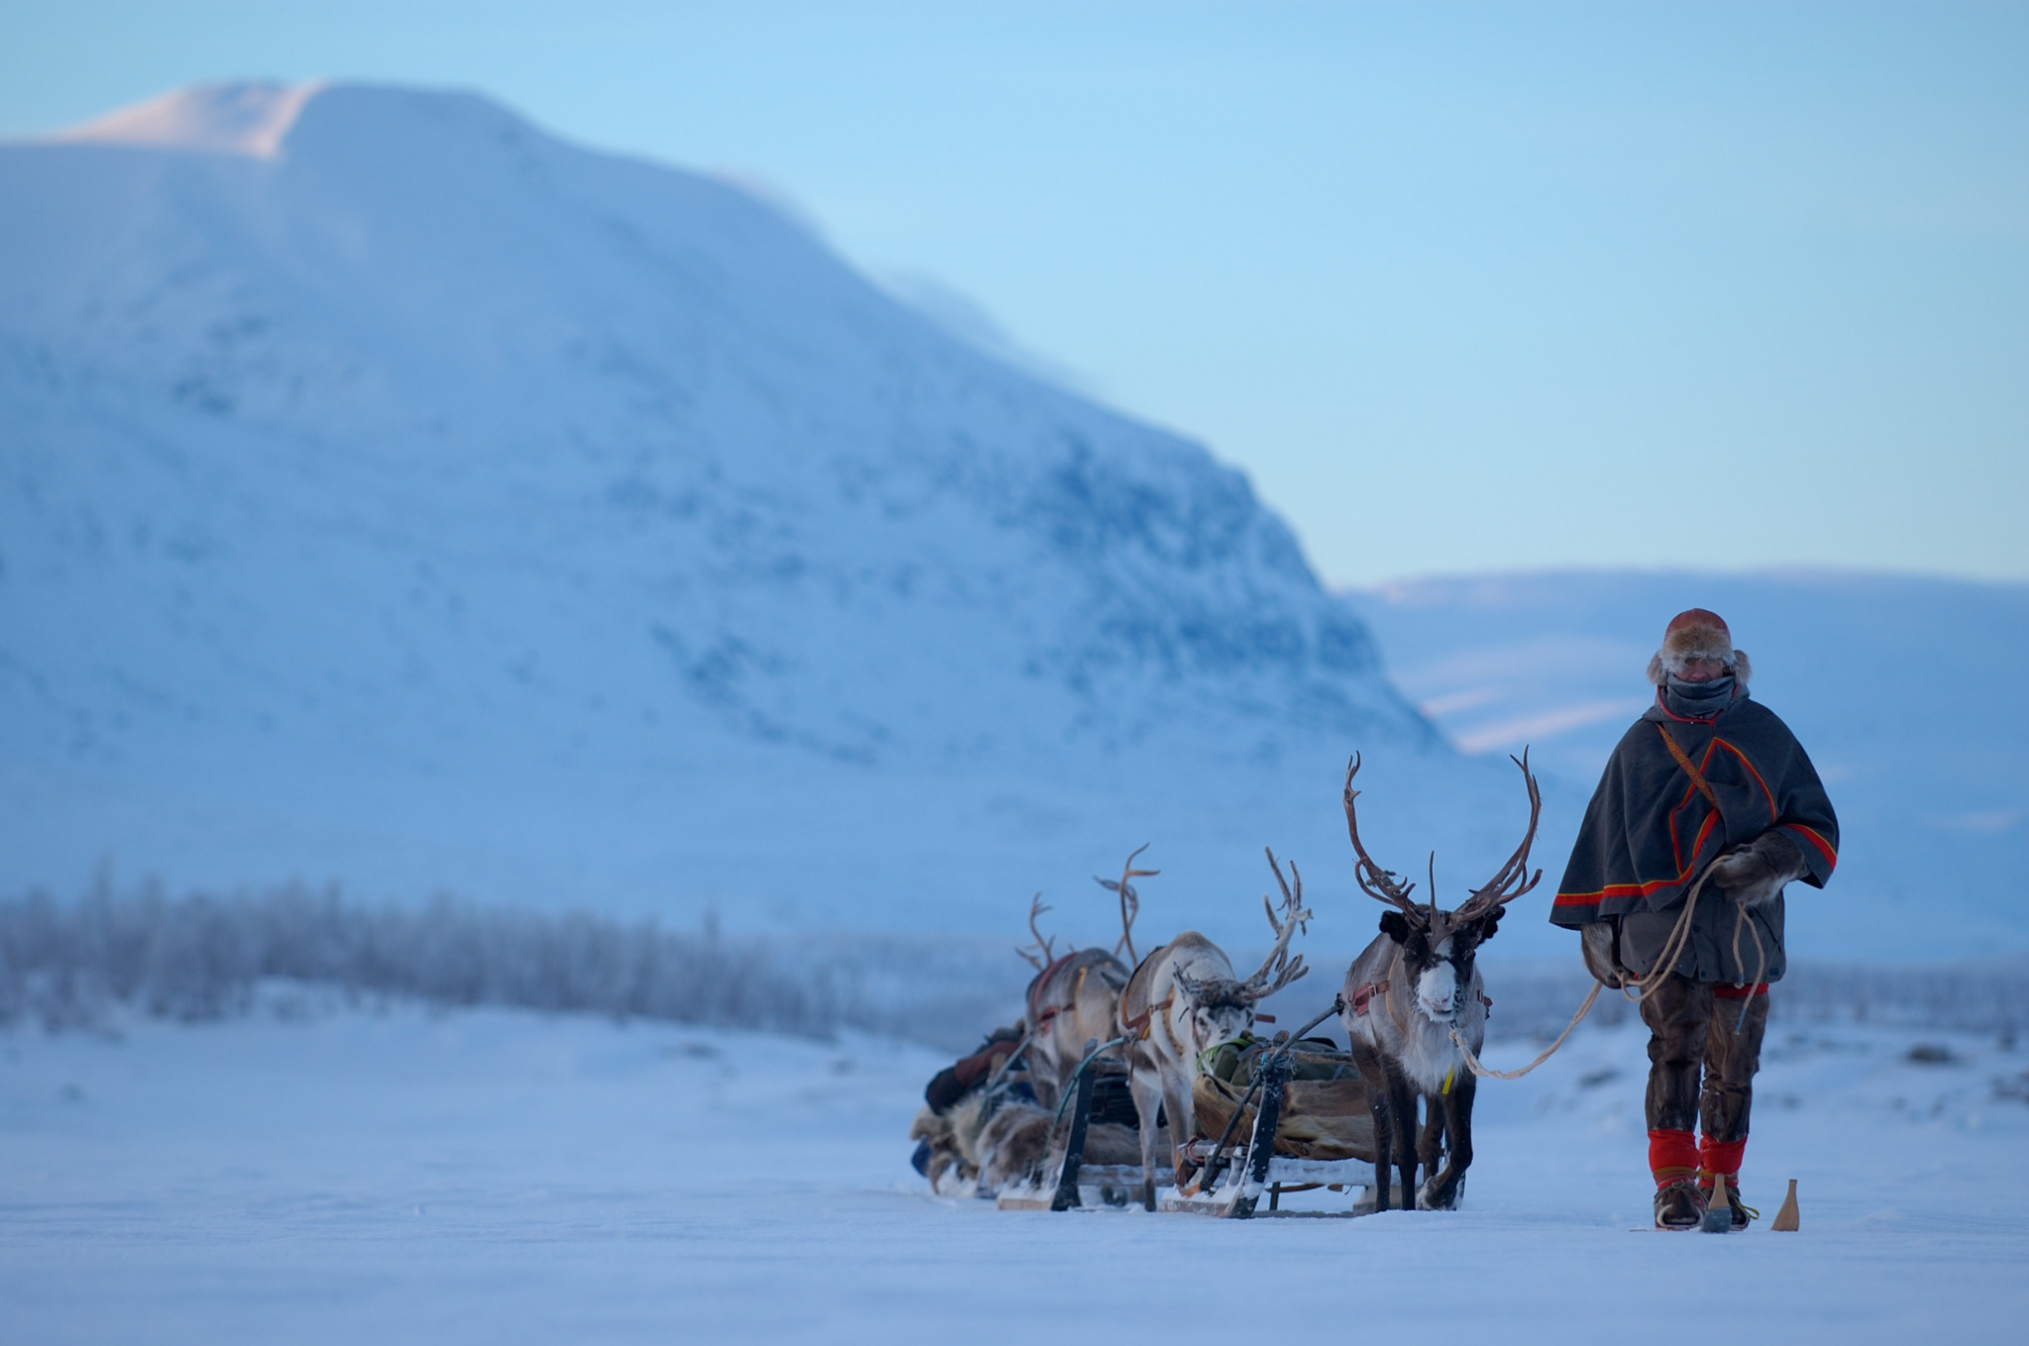
Who lives in Sweden today?
Around 10.4 million people live in Sweden
In 2020, around 20% of the population was born outside of Sweden
Around 20,000 Sami - indigenous population of the Arctic Circle
5 national minorities in Sweden - Jews, Roma, Sami, Swedish Finns and Tornedalers
Around 350, 000 Afro-Swedes

Slide 8
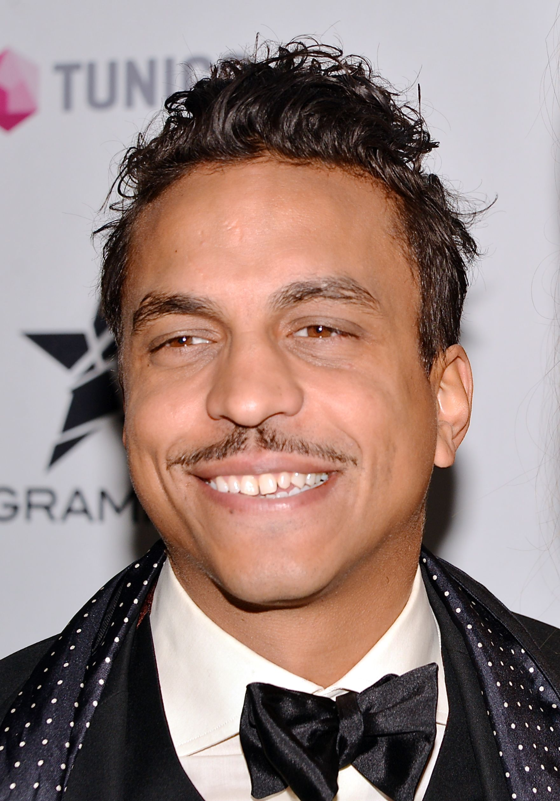
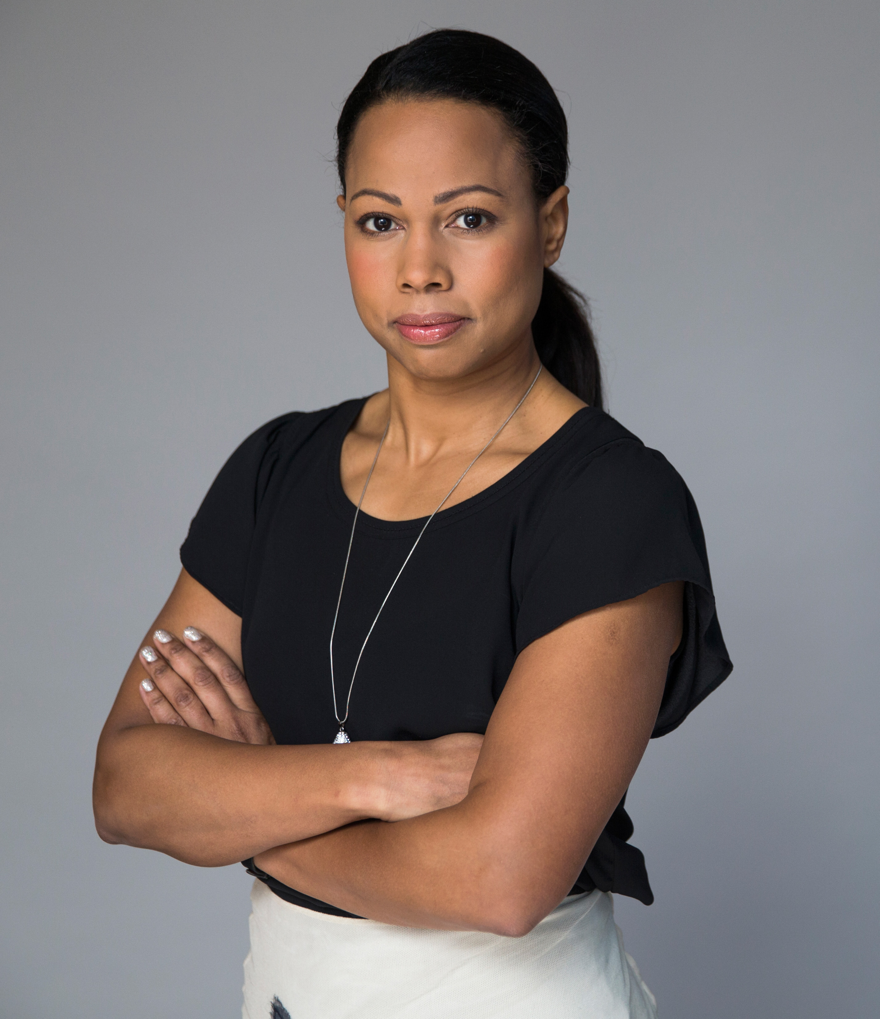
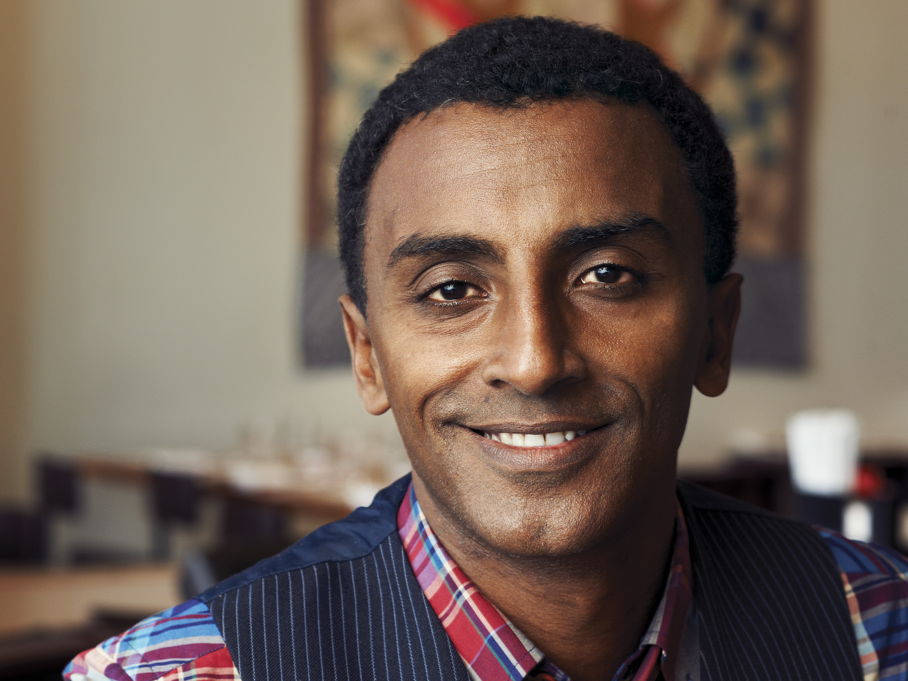
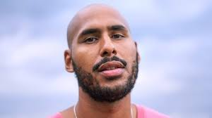
A few well-known Afro-Swedes (afrosvenskar)
Jason “Timbuktu” Diakité - rapper/author
Alice Bah Kunke - politician
Marcus Samuelsson - chef / author
Fanna Ndow Norrby/Amie Bramme Sey - podcast hosts / media presenters
Amat Levin - journalist / author
Seinabo Sey - musical artist

Slide 9
More information on Afro-Swedes
https://aaregistry.org/story/amie-bramme-sey-media-journalist-born/
https://aaregistry.org/story/seinabo-sey-singer-born/
https://aaregistry.org/story/fanna-norrby-writer-born/
https://aaregistry.org/story/marcus-samuelson-chef-and-restaurateur-born/
https://aaregistry.org/story/jason-michael-bosak-singer-born/
https://aaregistry.org/story/alice-bah-kuhnke-politician-born/

Slide 10
In today’s lesson
Historical context - Migration in Swedish history
Who lives in Sweden today?
Well-known afrosvenskar
Check out part 2 to learn some Swedish vocabulary related to demographics

Slide 11
Sources
Afrosvenskar
Imagebank Sweden
Afrofobi report
Burlin, Alexander ”Sweden’s Shameful Record on Racism Shows Why We Need Black Lives Matter”, Jacobin, 6/2020
Migrationsverket – Historik
Nationen: Svensk slavhandel
Sami in Sweden
Sweden’s National Minorities
Swedish Immigration to Minnesota
Törngren, Sayaka Osanami, ”Understanding Race in Sweden: The Racialisation and Deracialisation of Multiethnic and Multiracial Swedes”, Nordic Journal of Social Research, 2022
Wikström, Peter and Hübinette, Tobias ”Equality data as immoral race politics: A case study of liberal, colour-blind, and antiracialist opposition to equality data in Sweden”, British Journal of Social Psychology, 2021.

