Slide 1
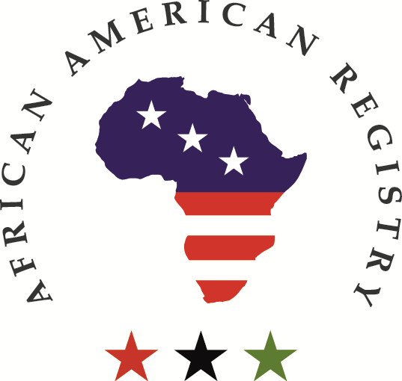
Ghana and Pan-Africanism: A contextual study of its history, geography, and community into the 21st-century.
A collaboration between the African American Registry and the Nkawa Foundation
Presented by Harriet Kofor-Acquah, Ghanaian Manager, and Law Student

Slide 2
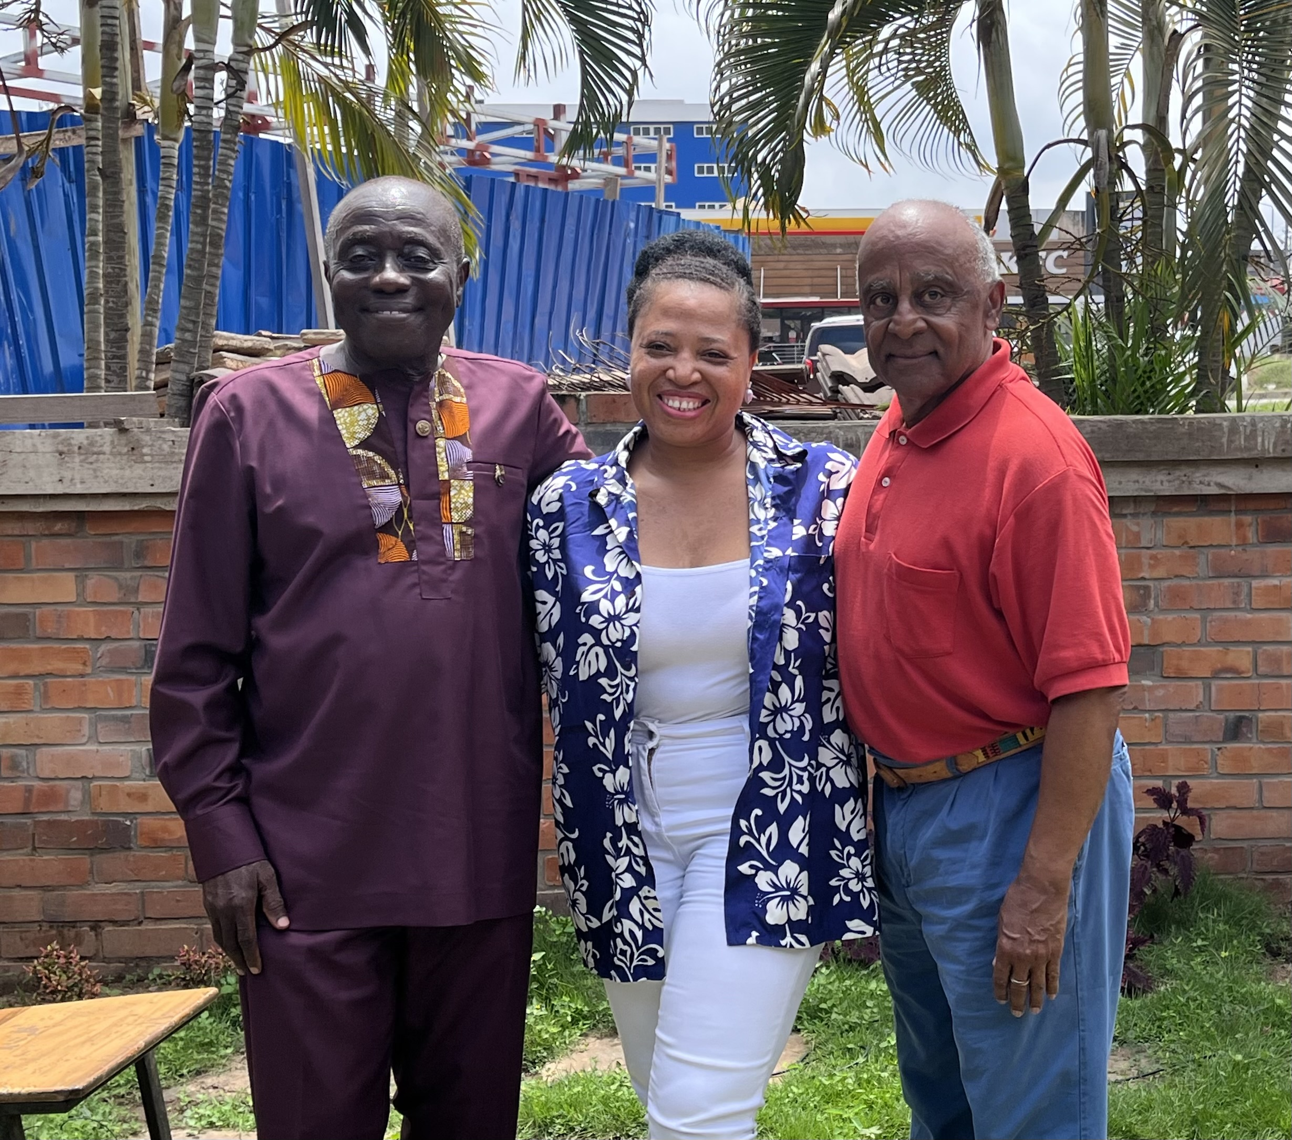
Hello, Akwaaba!
Notes:
Hello, Akwaaba, to lesson #1 of Street Team International, Ghana. I am Harriet Korkor-Acquah, a Ghanaian manager, and Law Student. Here I’m standing with Pan-African C.E.O. and Board Member Pashington Obeng (on my right) and Benjamin Mchie, Founder of African American Registry (on my left) in Accra, Ghana. I identify as she/her and identify as Ghanaian, our theme is Pan-Africanism in the 21st century.

Slide 3
Before We Start...
What images come to mind when you think of Ghana or Ghanian people?
Take a moment to think and jot down some notes.

Slide 4
In Today’s Lesson #1.
Part one of this learning abroad PowerPoint will:
Communicate a basic introduction to Ghana and its people.
Provide a context for understanding the position of All Ghanaian communities.
Below the PowerPoint (on this page) are four Video interviews on Pan-Africanism. The first two feature a Pan-African Heritage Museum co-founder and a high school student.
Lesson 1 will conclude with the symbolism of Ghana’s flag, followed by the demographics of Ghana and its cities, with a map for reference. For context, (below on this page) we have two more videos on Pan-Africanism from a University of Cape Coast professor and a college sophomore. For further study, we conclude with references and additional sources.
Notes:
This Learning Abroad PowerPoint #1 will Communicate a basic introduction to Ghana and its people.
Provide a context for understanding the position of Ghanaian communities. This information leads to video interviews on Pan-Africanism from a Pan-African Heritage Museum co-founder and a high school student.
Part 2 of this PowerPoint will include more videos on Pan-Africanism from a University of Cape Coast professor and a college student. Then, we will explore basic Ghanaian vocabulary related to African demographics

Slide 5
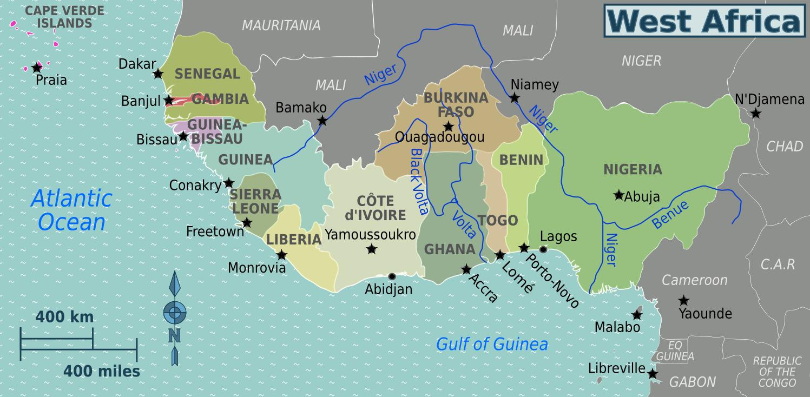
Where in the World is Ghana?
Ghana is part of West Africa: Benin, Burkina Faso, Cape Verde, The Gambia, Guinea, Guinea-Bissau, Ivory Coast, Liberia, Mali, Mauritania.
Ghana is about the size of America’s state of Oregon.
Notes:
Ghana is part of West Africa, along with Benin, Burkina Faso, Cape Verde, The Gambia, Guinea, Guinea-Bissau, Ivory Coast, Liberia, Mali, and Mauritania.
Ghana is about the size America’s state of Oregon.

Slide 6
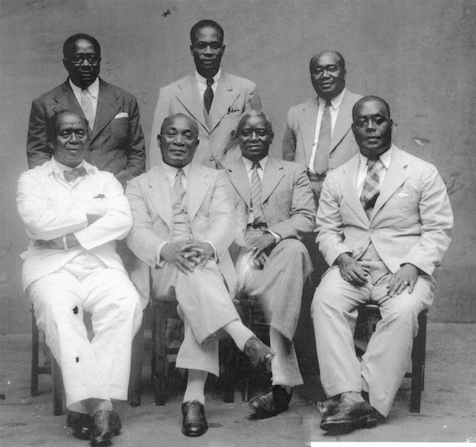
Historical Context : Ghana’s Story
The Ghana Empire began around 820 CE, near present-day Mauritania and Mali. The Portuguese invaded Ghana in the 15th century. On their arrival, they found an abundance of Gold along the river bodies such as Ankobra, Volta, among others, hence its first name, Gold Coast, because of the abundance of Gold. Soon, they began trading with the indigenes through their chiefs and family heads for human resources (labor) while they took the Gold away, which led to the slave trade. Europeans and chiefs traded slaves who worked under harsh conditions; some were killed.
There were plans to abolish the slave trade, which led to various ethnic wars, but to no avail. Finally, all ethnic groups united people in one nation and formed ‘the big six’ (thus, six great people) who led the entire country to attain independence and end the era of the slave trade and colonialism. Among the big six were astute Dr. Kwame Nkrumah and Dr. Joseph Boakye Danquah, after many deliberations and research into the history of the Land, named it G.H.A.N.A. on the eve of Ghana’s Independence, 5th March 1957.

Slide 7
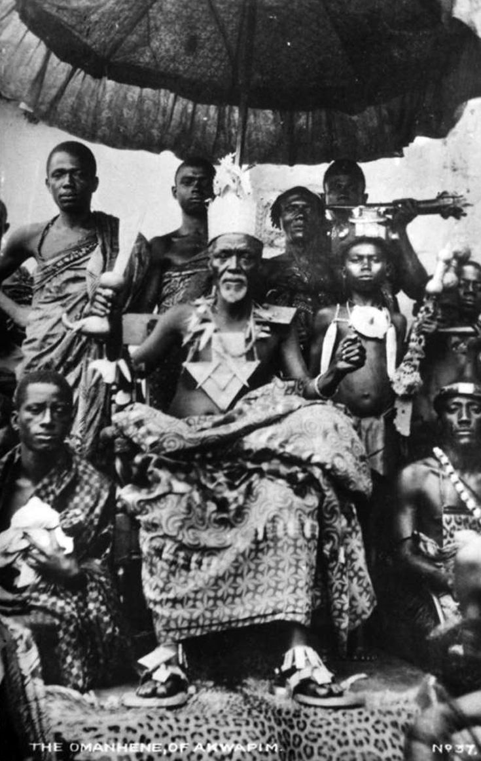
Historical Context : Ghana’s Story
As an acronym Ghana spelled means:
G means God.
H means Has.
A means Appointed.
N means Nkrumah.
A means Already or for Africa
Some believe that Ghana is a compound word (Ga-na) that means ‘warrior king,’ which is a word derived from Ouagadougou. This belief would mean that Ghanaians are initially from Burkina Faso, where we can find traces of such semantic phrases.

Slide 8
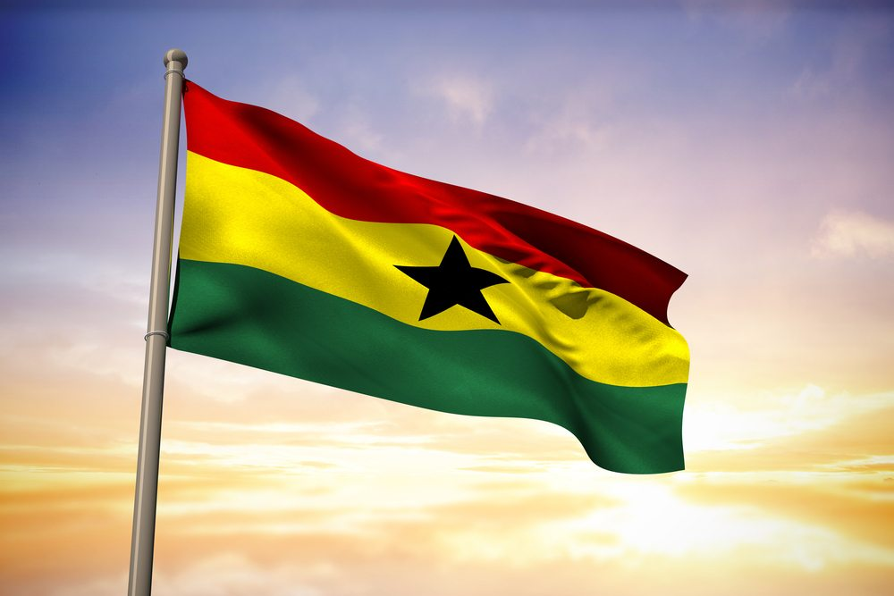
What the Flag of Ghana means
One symbol distinguishing Ghana from other African countries is the flag of Ghana. The flag of Ghana has four colors that represent who Ghanaians are, what they possess, and what binds them together as a people.
Red: The red color in the flag of Ghana represents the blood of the forefathers who died through the shedding of their blood during the slave trade. The red also represents the blood of those who died working on the plantations of enslavers in the diaspora.
Gold: This symbolizes “Gold” and other rich mineral resources in Ghana. Aside from gold, Ghana is blessed with magnesium and bauxite, to mention a few. These minerals help generate revenue for Ghana to aid developmental projects in Ghana.
Green: The green in the Ghana Flag Stands for the rich vegetation in Ghana. Ghana has fertile land that cultivates and produces crops, such as cocoa, which generates revenue for Ghana. Cashew, Palm Plantation, and Timber are equally in abundance in Ghana.
Black Star: Ghana prides itself as the star of Africa. The black star inside the flag, right in the middle, represents the people of Ghana.
The people of Ghana generally are dark in complexion. Modernization has evolved over the centuries. Hence, there has been inter-continental marriage and childbirth around the world. Ghana is not an exception to this 21st century, so there are mixed-race people in Ghana.

Slide 9
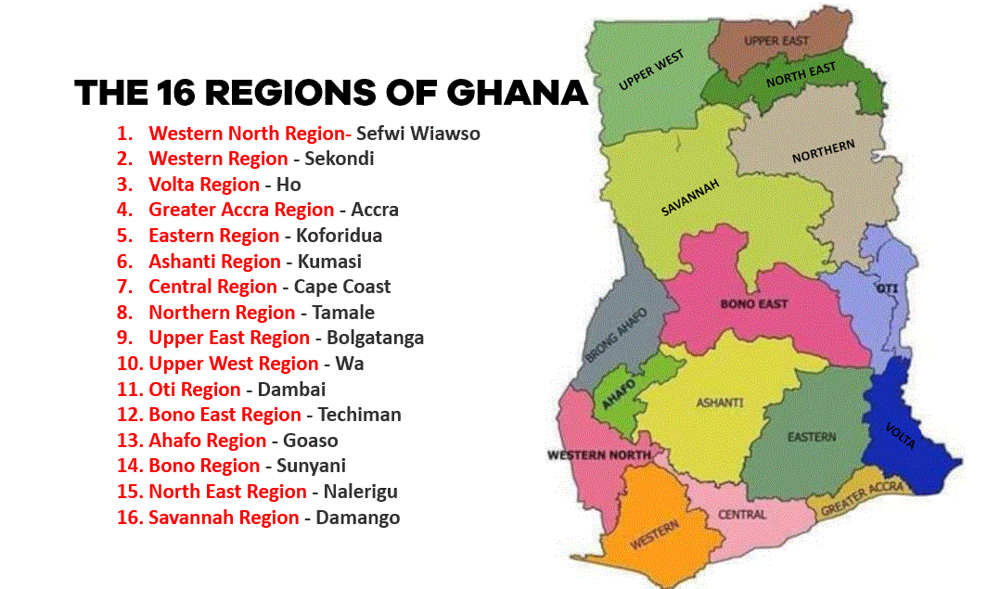
Who Lives in Ghana?
Around 34,121,985 people live in Ghana.
In 2023, The median age in Ghana was 20.7 years.
Infant Mortality Rate and Deaths of Children under 5 Years Old in Ghana is 32.1, and 43.5.
The Largest cities in Ghana are:
1. Accra, 1,963,264
2. Kumasi, 1,468,609
3. Tamale, 360,579
4. Takoradi, 232,919
5. Atsiaman 202,932

Slide 10
Also in Today’s Lesson #1.
For further study, the following two slides contain online references and additional sources.
For further perspective, at the bottom of this page we have two video interviews on Pan-Africanism. We have a University of Cape Coast professor and a college sophomore.
Part 2 of this PowerPoint on this page will explore basic Ghanaian vocabulary related to African demographics with further interview commentary on Pan-Africanism.
Notes:
This Learning Abroad PowerPoint #1 will Communicate a basic introduction to Ghana and its people.
Provide a context for understanding the position of Ghanaian communities. This information leads to video interviews on Pan-Africanism from a Pan-African Heritage Museum co-founder and a high school student.
Part 2 of this PowerPoint will include more videos on Pan-Africanism from a University of Cape Coast professor and a college student. Then, we will explore basic Ghanaian vocabulary related to African demographics

Slide 11
Online References on Ghana
Kwame Nkumah
Thomas Sankara
Ghana Independence
The Ghana Empire
The Pan-African Congresses
The United Negro Improvement Association, UNIA
Pan-Africanism

Slide 12
Additional Sources
NKWA Foundation
Pan African Heritage Museum
The Convention Peoples Party
The United Gold Coast Convention
Joseph Danquah
George Paa Grant
The West African Students Union

