Slide 1
Ghana and Pan-Africanism Part 2: Recent demographic Trends in Ghana, and useful Vocabulary
A collaboration between the African American Registry and the Nkawa Foundation
Presented by Harriet Kofor-Acquah, Ghanaian Manager, and Law Student
Notes:
Hi, welcome to the recent demographic trends in Ghana, this PowerPoint is part of a two-part study abroad series brought to you by the African American Registry and the Nkwa Foundation. It is presented by me Harriet Kofo-Acquah.

Slide 2
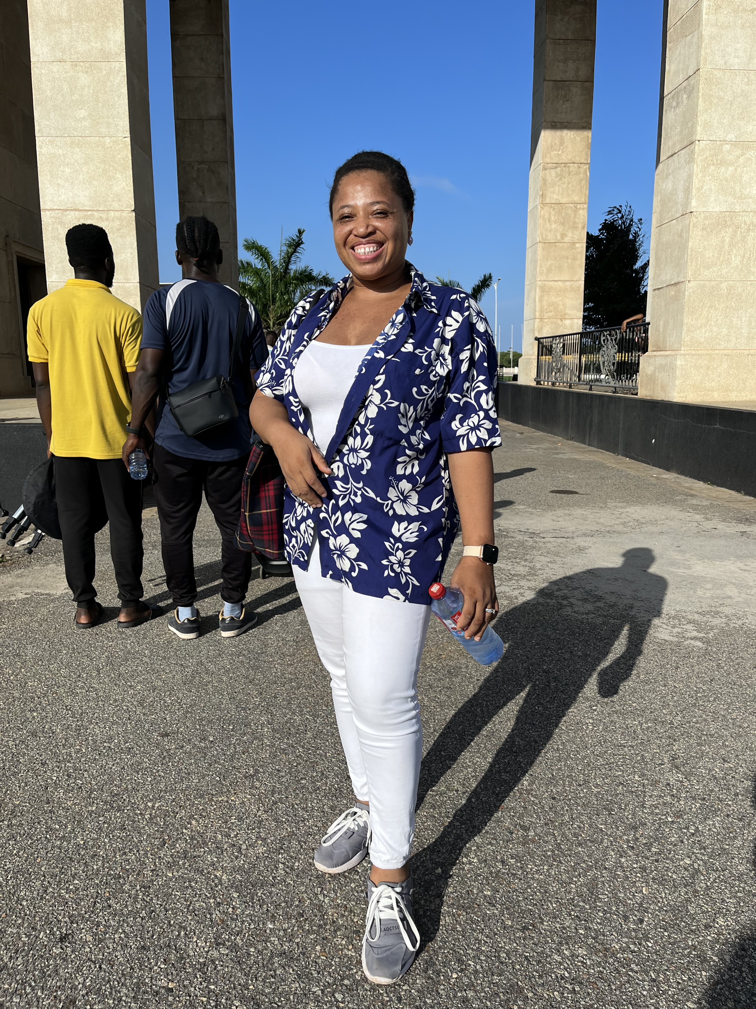
Hello, Akwaaba!
Notes:
Hello, Akwaaba, to lesson #1 of Street Team International, Ghana. I am Harriet Korkor-Acquah, managing director of Union Group Companies, and a Ghanaian Law Student. Here I’m standing in Black Star Square, Accra, Ghana. I am an Akan, and my first language is Twi.

Slide 3
In Today’s Lesson #2
In today’s lesson #2
Street Team International will present background through basic Ghanaian vocabulary related to Ghanaian demographics.
At the bottom of this page, Street Team International will share four videos for understanding Ghanaian positions on Pan-Africanism. The commentary comes from the first two feature PAHM CEO, Pashington Obeng and Joshua Kessie, a high school student.
Notes:
In this lesson, our objectives are to continue to learn of Pan-Africanism. The next two slides are videos for understanding Ghanaian positions on Pan-Africanism. Later, Street Team International will present context through basic Ghanaian vocabulary related to Ghanaian demographics

Slide 4
In Today’s Lesson #2, Twi Language
The next four slides will present basic Ghanaian vocabulary related to Ghana
These four vocabulary slides will be translations from Twi to English.
Notes:
In this lesson, The next four slides will present basic Ghanaian vocabulary related to Ghana. These four vocabulary slides will be translations from Twi to English.

Slide 5
Vocabulary Slide 1
Twi
nnipa dodow ho nsɛm
nnipa dodoɔ
ɛhɔfo a wɔyɛ aborɔfo
ɔman / aman
Ghana
Ghanafoɔ
English
demography
population
indigenous people
country / countries
Ghana
Ghanaian

Slide 6
Vocabulary Slide 2
Twi
atubrafo ho nsɛm
atubrafo
atutra a wɔde kɔ mmeae foforo
sɛ wobɛtu akɔ baabi foforɔ
sɛ wobeguan
Pan-Africanfoɔ
guankɔbea hwehwɛfo
hɔhoɔ
English
immigration
immigrant
migration
to move
to flee
Pan-African
asylum seeker
foreign

Slide 7
Vocabulary Slide 3
Twi
tu mmirika
mmusuakuw
mu nyiyim mmusua mu
nyiyim mmusuakuw a wofi mu
mmusuakuw mu kuw
nkannyan a wɔde tia mmusuakuw bi
atubrafo a wɔyɛe
Abusuakuw
kɔla anifurae (kɔla anifurae mmusua mu nyiyim) .
English
race
racialized
racism
ethnicity
ethnic group
incitement against an ethnic group
colonialism
Tribe
color blindness (color blind racism)

Slide 8
Vocabulary Slide 4
English
culture
identity
Black
White
Non-White
Afrakian
Africa
Black Lives Matter
Twi
amammerɛ
adida
Tuntum
Fitaa
Wɔn a Wɔnnyɛ Aborɔfo
Afrakian na ɔkyerɛwee
Afrika
Abibifo Nkwa Ho Hia

Slide 9
In today’s Lesson #2
The next slide provides references for a deeper understanding of Pan-Africanism.
Below this PowerPoint at the bottom of this page, Street Team International will share two more videos for understanding Ghanaian positions on Pan-Africanism. The commentary comes from professor Valere Botchway of the University of Cape coast and Goldine Kweku Graham, a college student.
In conclusion, as the first African country to gain independence from colonialism, Pan-Africanism through Ghana is a natural place for learning. The final Street Team International slide has sources and references for further abroad study, I appreciate your time; Madase.
Notes:
The next two slides will provide a video interview for deeper understanding of Pan-Africanism. The commentary comes from PAHM CEO, Pashington Obeng and Joshua Kessie, a high school student.
As the first African country to gain independence from colonialism, Pan-Africanism through Ghana is a natural place for learning. The final Street Team International slide has sources and references for further abroad study, I appreciate your time; Madase.

Slide 10
References
NKWA Foundation
Pan African Heritage Museum
Pan-African Resources
Britannica. COM
Historians.org
Thoughtco.com
Pan-African Congress.org

